Slide 1
Nature of Personality and Daily Spatial Behavior: A Longitudinal Study in Adolescent Twins
Shiloh Zhou B.S., Department of Psychology, University of Minnesota

Slide 2
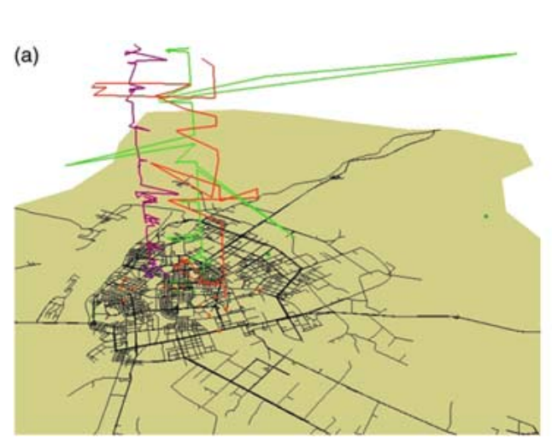
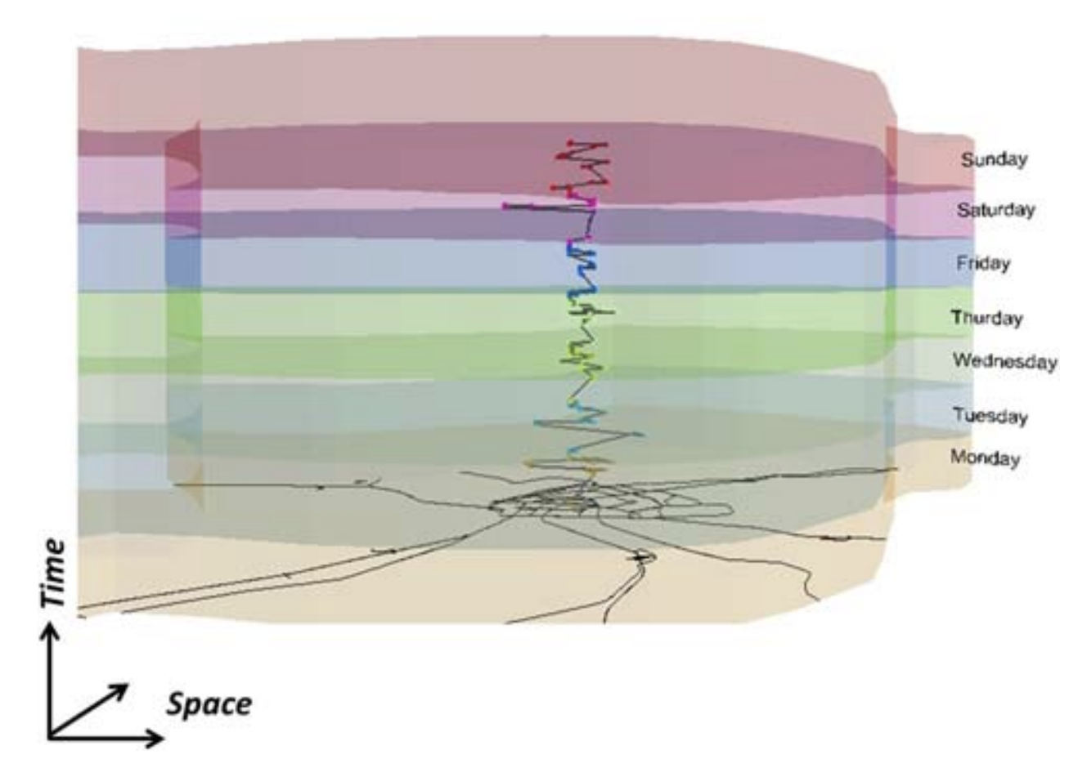
Spatial behavior and individual differences
Spatial Behavior and Individual Differences
Spatial behavior shows individual differences
Number of places visited
Distance traveled
Activity space
Entropy (or predictability)
Space: x-axis and y-axis are latitude and longitude
Gao, 2015

Slide 3
Daily Spatial Behavior and Personality are Related
Spatial Behavior and Personality are Related
Personality and Spatial Behavior Are Related
 | Places Visited | Distance Traveled | Activity Space (Range) | Entropy
Extraversion | + | + | + | +
Openness | + | +
Conscientiousness | -/+ |  |  | -
Agreeableness |  |  | +
Neuroticism | - |  |  | -
Ai, Liu, & Zhao, 2019; Alessandretti et al., 2018; Chorley, Whitaker, & Allen, 2015; de Montjoye et al., 2013; Mønsted, Mollgaard, & Mathiesen, 2018

Slide 4
Our Research Questions
How does spatial behavior develop in adolescence?
How are these behaviors related to personality?
What are the respective roles of genes and environment in spatial behavior?

Slide 5
Colorado Online Twin Study (CoTwins)
CoTwins: An Online Intensively Longitudinal Study of Adolescent Twins
Intensive longitudinal assessment
110 MZ and 225 DZ twin pairs (670 total participants, 400 addt’l twins being recruited now)
77.1% non-Hispanic white, 14.7% Hispanic, ~8% other
55% percent female
Intake assessment at age 14-17 and during which smartphone app is installed
The mean age at intake was 16.1 (SD=1.1)
Follow-up intensive longitudinal assessments for 2 years (now extended to 4 years)

Slide 6
Personality Data Description
Personality Descriptive Statistics
Big Five Inventory scale | Cronbach’s Alpha |  | Mean (SD)
 | CoTwins | Normative Sample | CoTwins | Normative Sample
Extraversion | 0.85 | 0.85 | 3.3 (.82) | 3.9 (.61)
Agreeableness | 0.75 | 0.82 | 4.0 (.56) | 3.6 (.61)
Conscientiousness | 0.75 | 0.84 | 3.7 (.62) | 3.3 (.67)
Neuroticism | 0.81 | 0.85 | 2.7 (.76) | 1.8 (.67)
Openness | 0.72 | 0.80 | 3.5 (.56) | 3.5 (.59)
John, & Srivastava, 1999; Lounsbury, Tatum, Gibson, Park, Sundstrom, Hamrick, & Wilburn.,2003

Slide 7
Location Data Collection and Description
Location Data Collection and Descriptive Statistics
21,016,920 location points collected via smartphone app
Extracted 604,261 Stay Point
Derived four daily spatial behaviors based on stay points
Number of places visited each day
Daily distance traveled
Daily activity space
Daily entropy

Slide 8
Daily Spatial Behavior is Highly Reliable
Daily Spatial Behavior is Highly Reliable
Daily Spatial Behavior is Highly Reliable
Daily Spatial Behaviors | Mean | Standard Deviation | Split-Half Reliability
Number of Places | 3.66 | 2.06 | 0.95
Distance Travelled (km) | 17.60 | 26.86 | 0.92
Activity Space (km) | 9.86 | 17.56 | 0.94
Entropy | 1.34 | 0.8 | 0.85

Slide 9
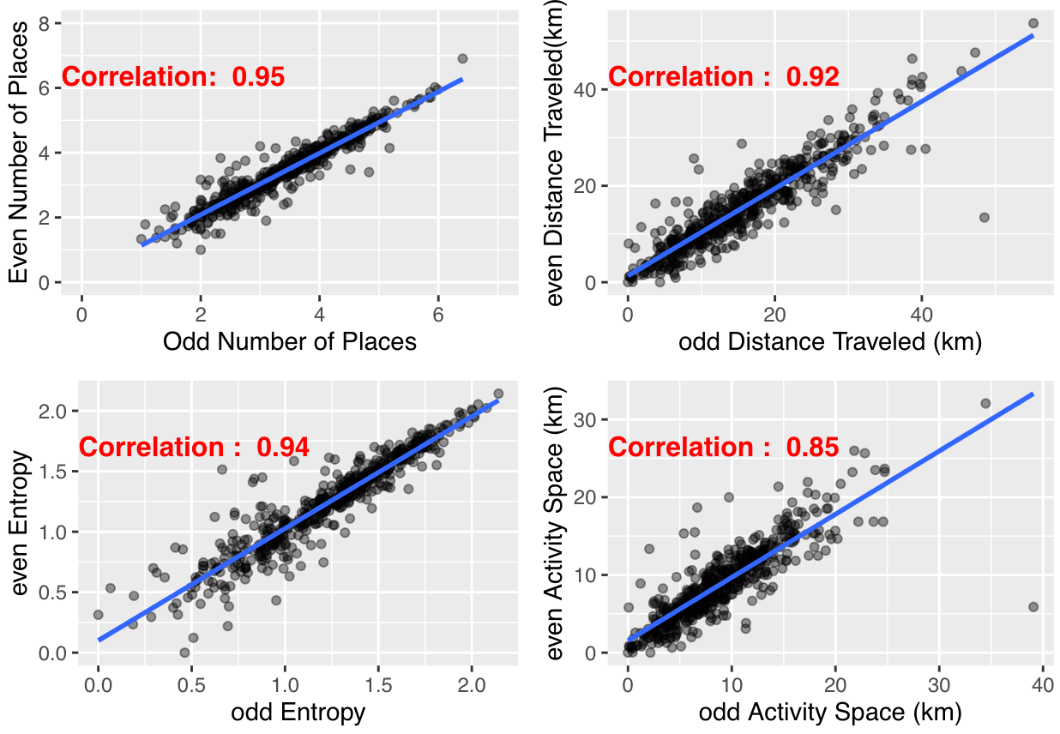
Daily Spatial Behavior is Highly Reliable
Daily Spatial Behavior is Highly Reliable

Slide 10
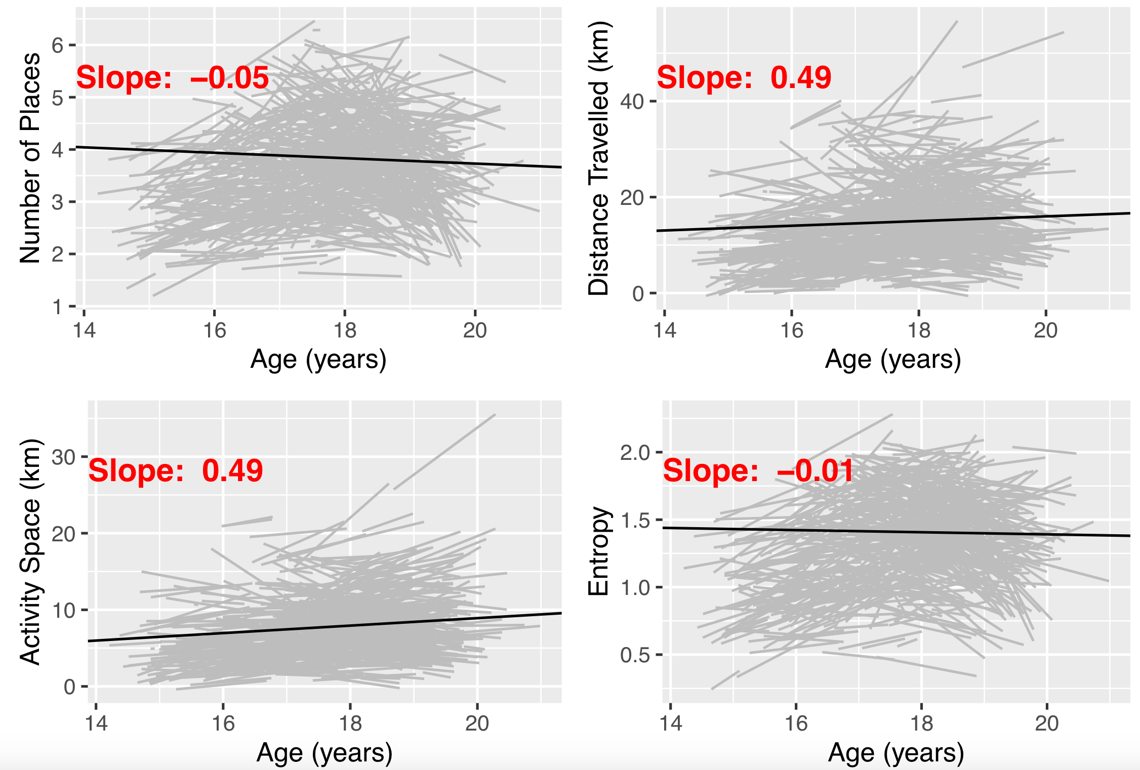
Daily Spatial Behavior is Stable over Time
Daily Spatial Behavior is Stable Over Time
*
p < 0.001 ‘***’, p < 0.001 ‘**’, p < 0.01 ‘*’

Slide 11
Personality and Spatial Behavior are Correlated
Personality and Spatial Behavior are Correlated
 | Number of Places | Distance Travelled | Activity Space | Entropy
Openness | -0.09* | -0.13** | -0.14** | -0.1*
Conscientiousness | 0.07 | 0.13** | 0.14** | 0.08
Extraversion | 0.1* | 0.07 | 0.09* | 0.1*
Agreeableness | ~0.00 | -0.02 | ~0.00 | 0.01
Neuroticism | -0.02 | -0.07 | -0.1* | -0.02
⁎⁎p < 0.01, ⁎p < 0.05

Slide 12
Daily Spatial Behavior is Influenced by Genes and Environment
Spatial Behavior is influenced by Genes and Shared Environment
Notes:
Here we present the analysis of variance for each spatial behavior.
We follow the classical twin model and decompose the variances in spatial measures into three components: Heritability, shared environmental effects and the non-shared environment effects. Heritability refers to the variance attributable to the additive effects of individual genes; Shared environmental effects refers to the variance attributable to environmental influences shared by twins raised in the same family; the non-shared environmental effect is the variance attributable to environment influences unique to the individual.
The main finding is is that three of the four phenotypes show substantial increases in heritability, although no sense of error or confidence intervals here. The increase happens around age 16-18, just as we would expect as adolescents become freer to go where they want; when they want.

Slide 13
Summary and Conclusion
Summary and Conclusion
Daily spatial behavior is stable over time
Personality correlates with daily spatial behavior
Heritability of daily spatial behaviors increases substantially between age 16 and 18

Slide 14


Acknowledgements
Grant
National Institutes of Health grant
U01 DA046413
PIs
Scott Vrieze, PhD
Naomi Friedman, PhD
The Vrieze Lab
Stephanie Zellers, MA
Seon-Kyeong Jang, MA
Gretchen Saunders, PhD
Mengzhen Liu, PhD

